Slide 1
Data Analytics Task
Anna Abrahamyan

Slide 2
1
2
Tools used for this task
3
4
Python
Excell
Mainly used for data scraping and cleaning
Used for data cleaning
R Studio
Google Slides
Used for visualizing the analysis
Used for presenting the task

Slide 3
STEP 1
Data Scraping

Slide 4
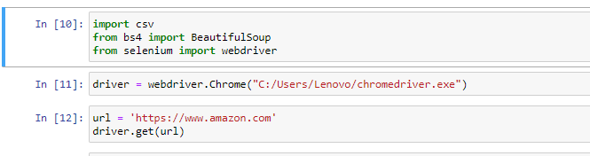


Slide 5
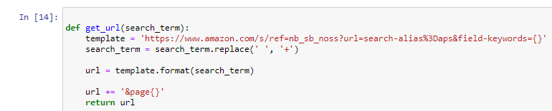

Slide 6
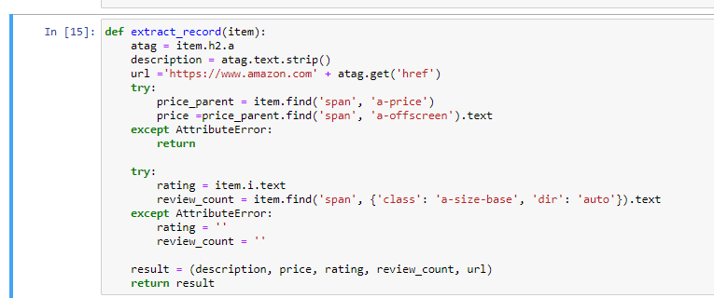

Slide 7
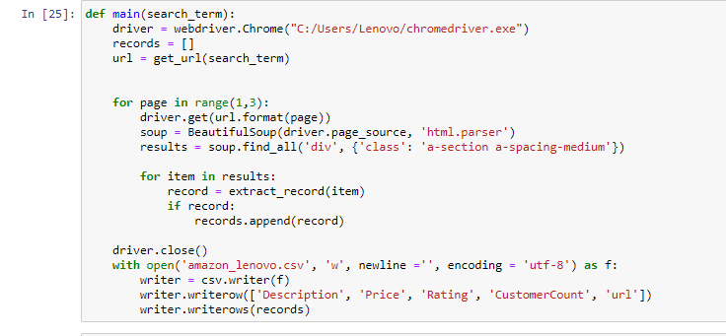

Slide 8
STEP 2
Merging the
csv files together

Slide 9
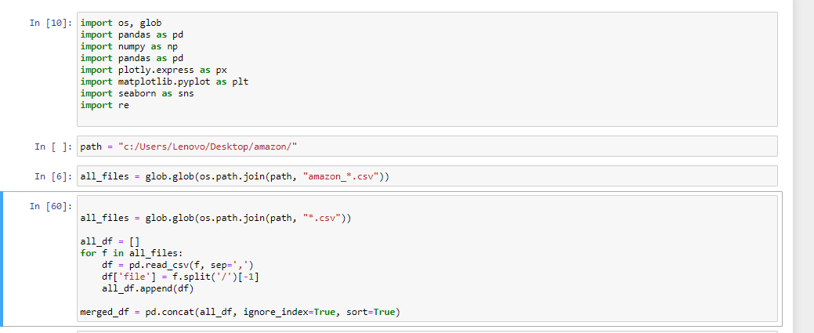

Slide 10
STEP 3
Data Cleaning

Slide 11
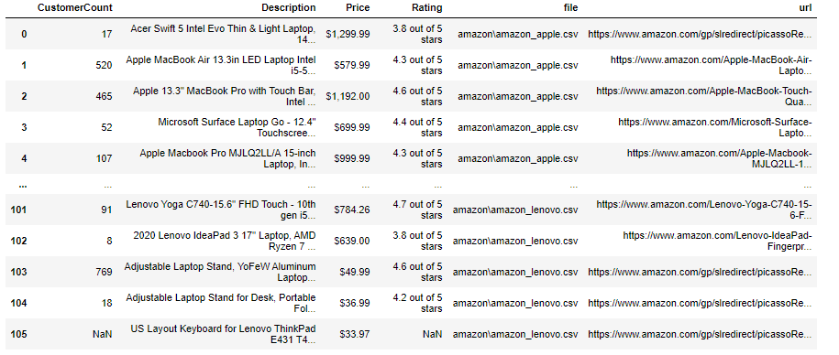
—SOMEONE FAMOUS
Data BEFORE Cleaning
“This is a quote. Words full of wisdom that someone important said and can make the reader get inspired.”

Slide 12
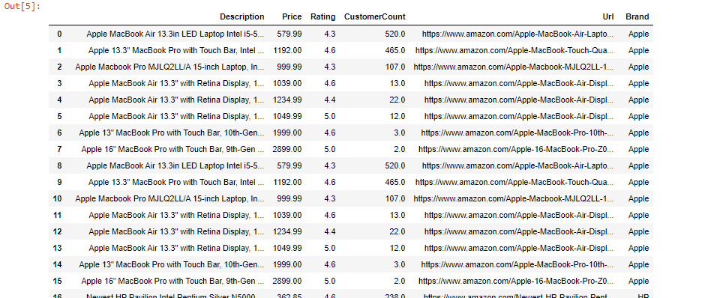
Data AFTER Ceaning

Slide 13
STEP 4
Data Visualization

Slide 14
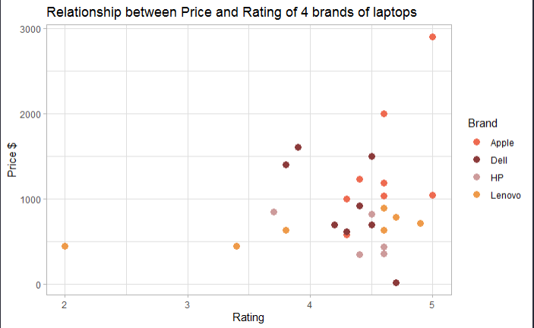
—SOMEONE FAMOUS
“This is a quote. Words full of wisdom that someone important said and can make the reader get inspired.”
Lenovo has lower price, but also has lower rating from 2-4.9. Apple has the highest price and also the highest ratings.

Slide 15
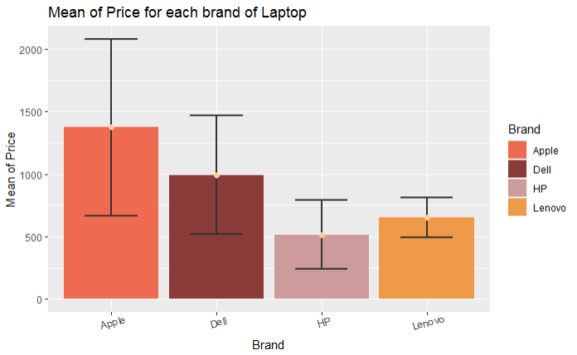
—SOMEONE FAMOUS
“This is a quote. Words full of wisdom that someone important said and can make the reader get inspired.”
The error bars(black lines) represent how spread our data is around the mean value and thus check the reliability of the mean value. Smallest one is Lenovo, so the mean is reliable for Lenovo laptops price,meanwhile Apple’s mean of price is not reliable
Notes:
Here we can see how spread our data is around the mean value, we can check the reliability of our mean value for each bar. The smaller the error bar is then more reliable our mean value is.

Slide 16
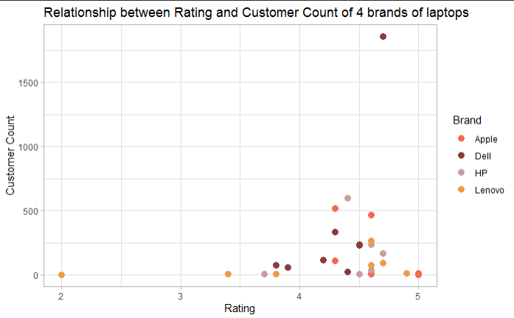
—SOMEONE FAMOUS
“This is a quote. Words full of wisdom that someone important said and can make the reader get inspired.”
Here we can see that lowest Rating and also customer count is for Lenovo, Dell has highest customer count and also the rating is very good. And Apple and HP also have good rating.

Slide 17
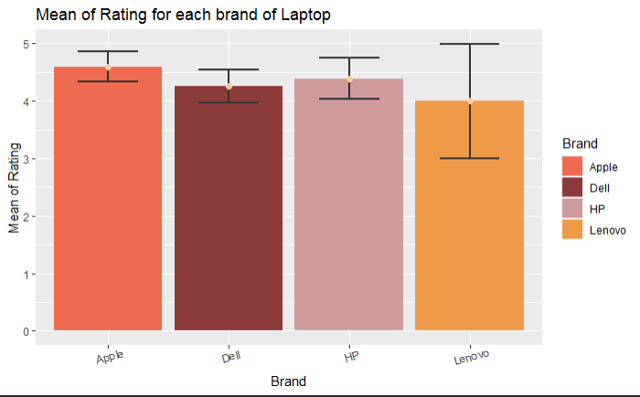
—SOMEONE FAMOUS
“This is a quote. Words full of wisdom that someone important said and can make the reader get inspired.”

Slide 18
Thank you!

